Slide 1

The Free Gift
The Salvation message

Slide 2

The Inherent Simplicity of the Gospel Message &
Full Teachings in the book of Romans

Slide 3

Dr. Andy Woods the gospel shared in its inherent simplicity
http://www.spiritandtruth.org/teaching/topics_by_andy_woods_05/57_The_Simple_Gospel/20130407_57_the_simple_gospel.mp3?x=x

Slide 4

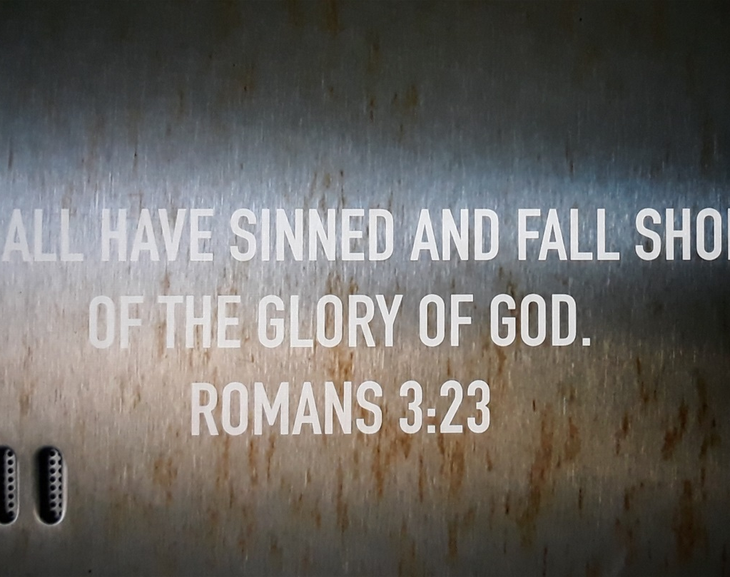
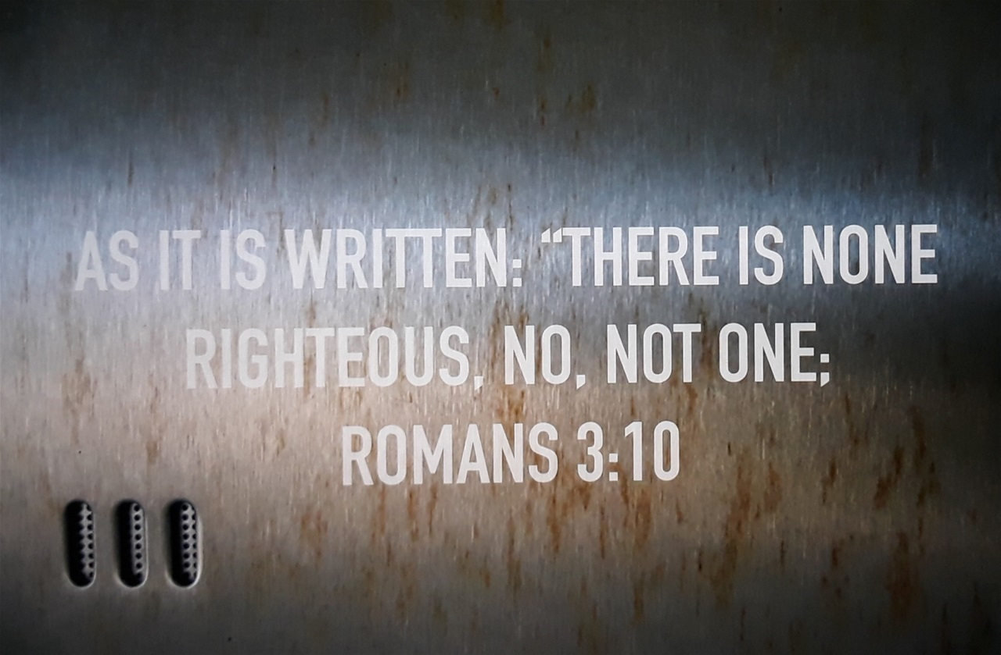
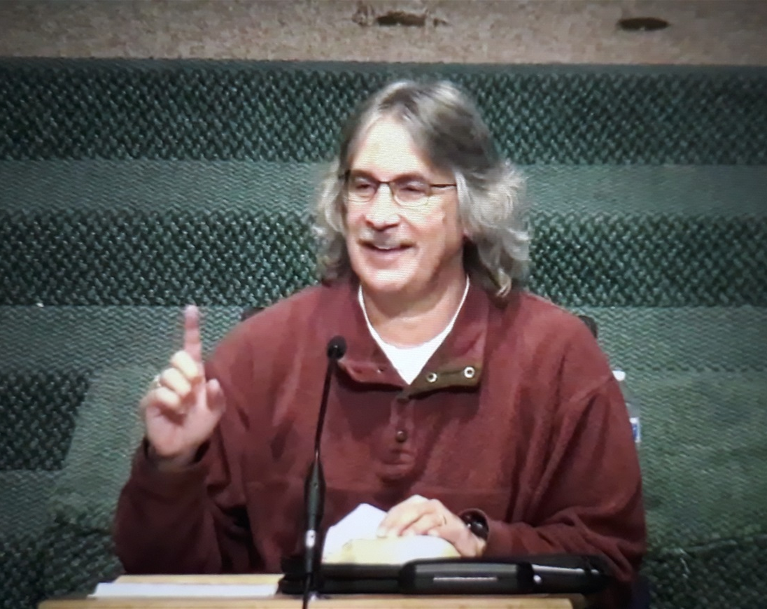

Teachings by
Pastor Chris Quintana
Romans 2:17-3:20
https://youtu.be/xvnyiEc_QY4
Romans 3:21-31
https://youtu.be/zek4ZbfZIuo
Romans 4:1-25
https://youtu.be/oq4hbCpaoYc

Slide 5
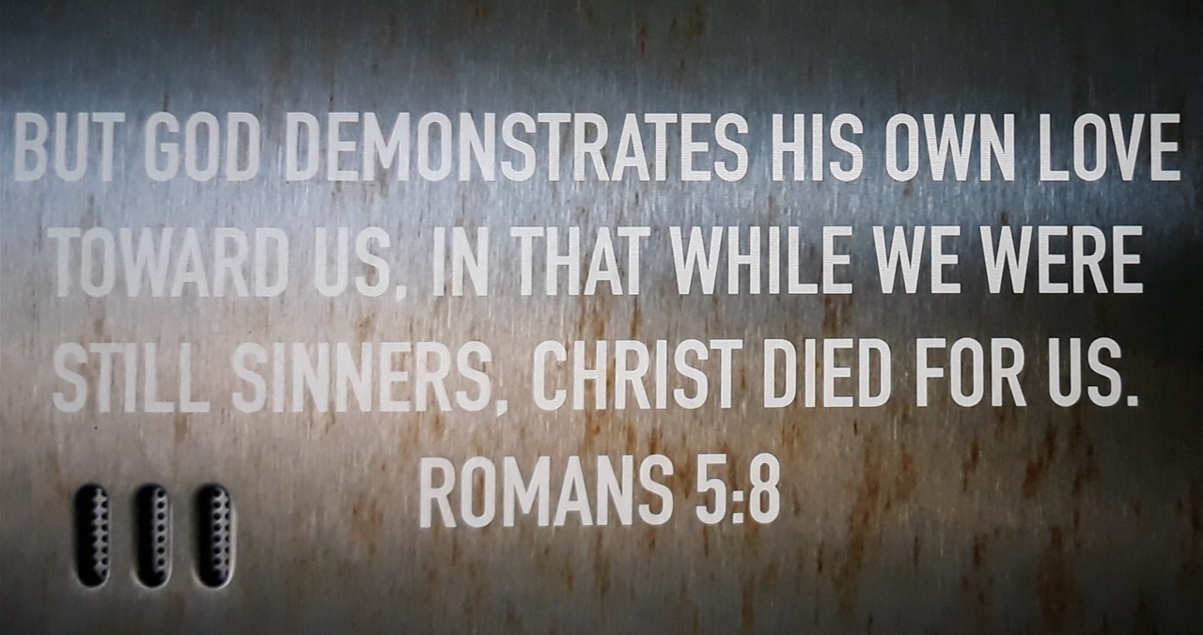
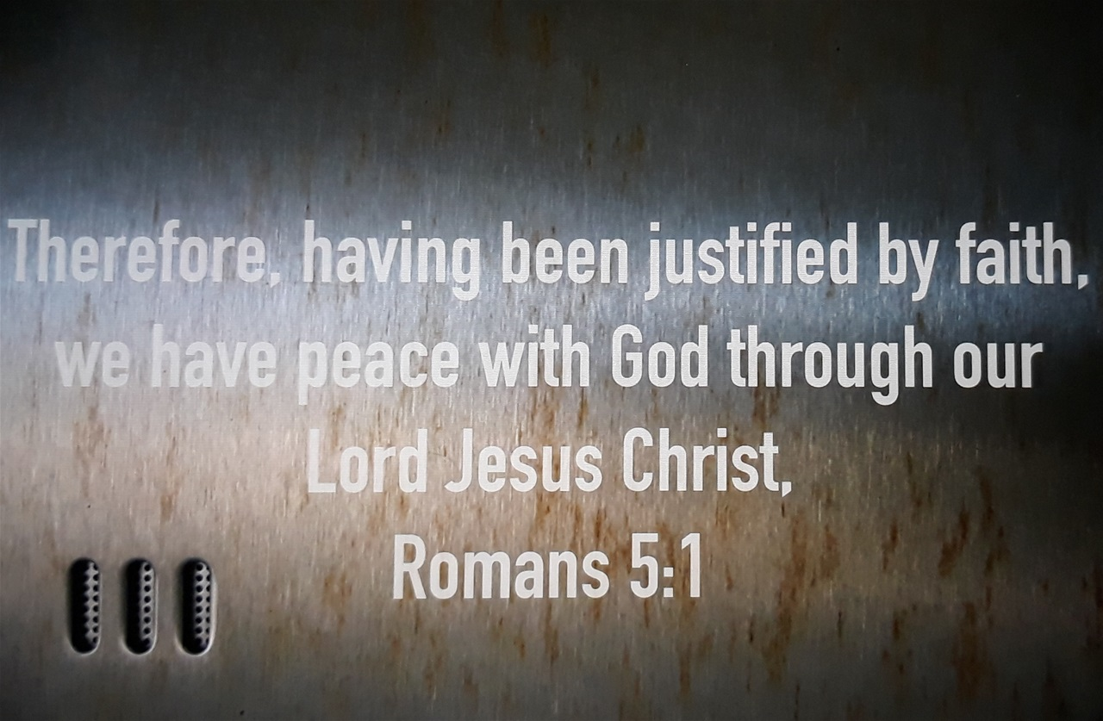
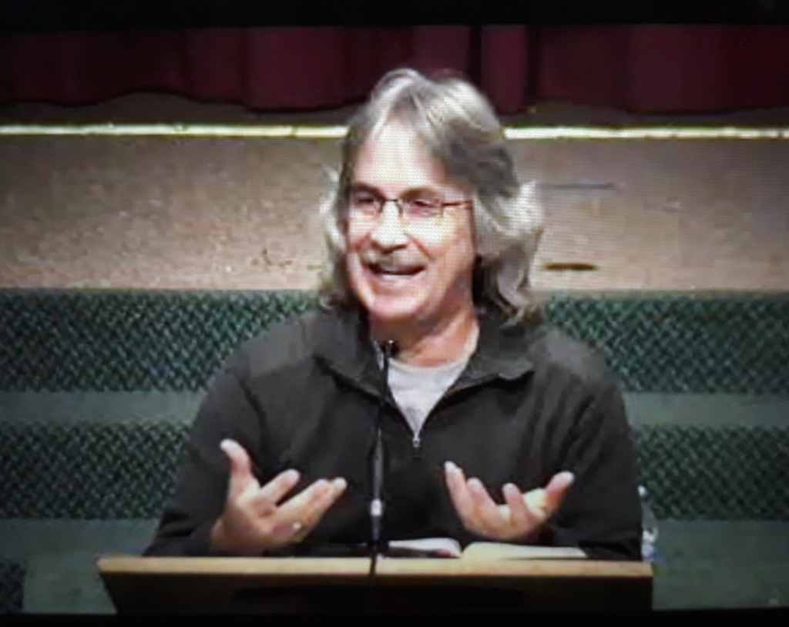
Pastor Chris Quintana
Romans 5:1-11
https://youtu.be/aW-gS9_c6Ig
Romans 5:12-6:2
https://youtu.be/uu2Jmjp3YCY

Slide 6
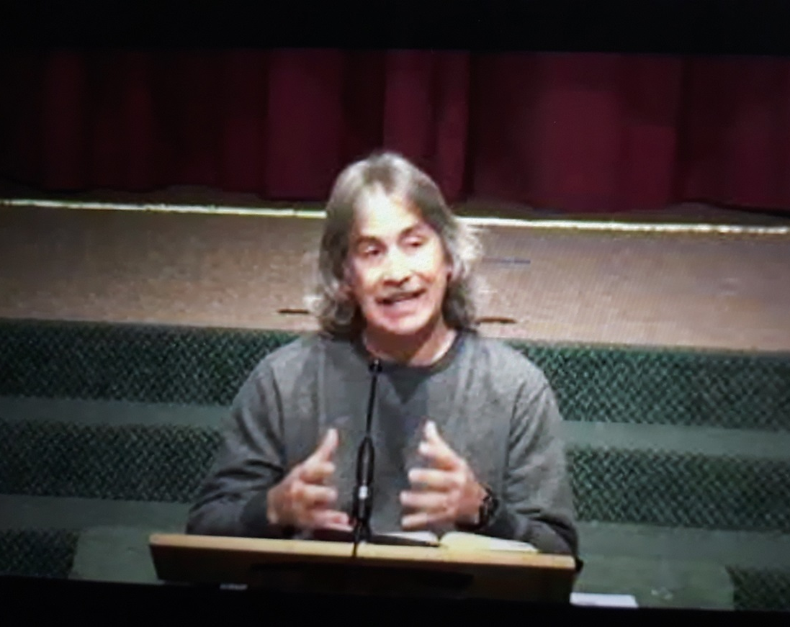
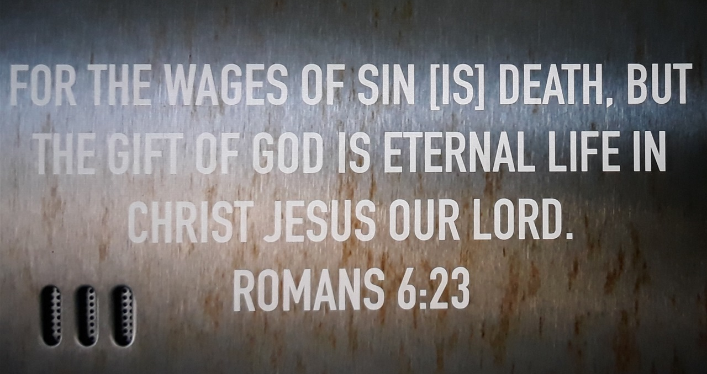
Pastor Chris Quintana
Romans 5:18-6:14
https://youtu.be/MFG3WTZouew
Romans 6:15-7:8
https://youtu.be/Ify5bJvvd2E

Slide 7
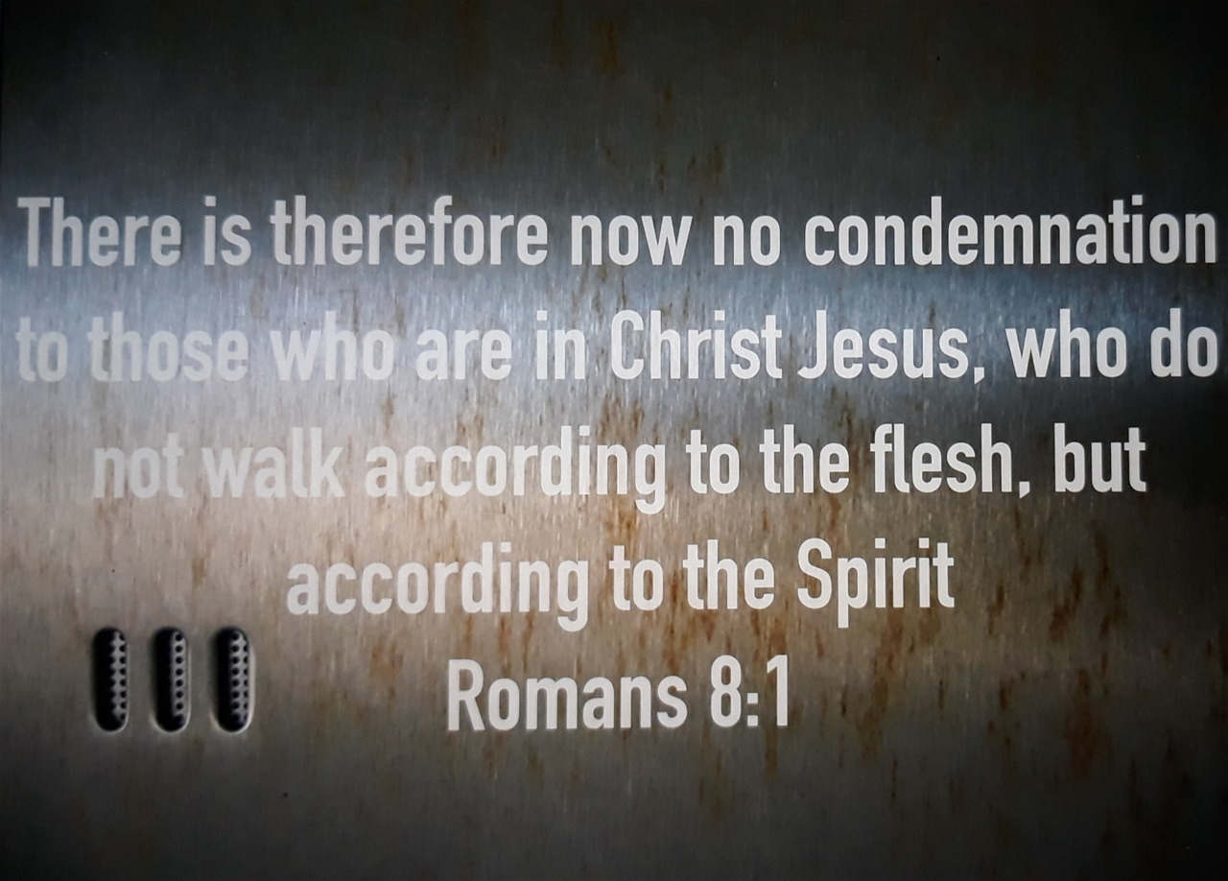
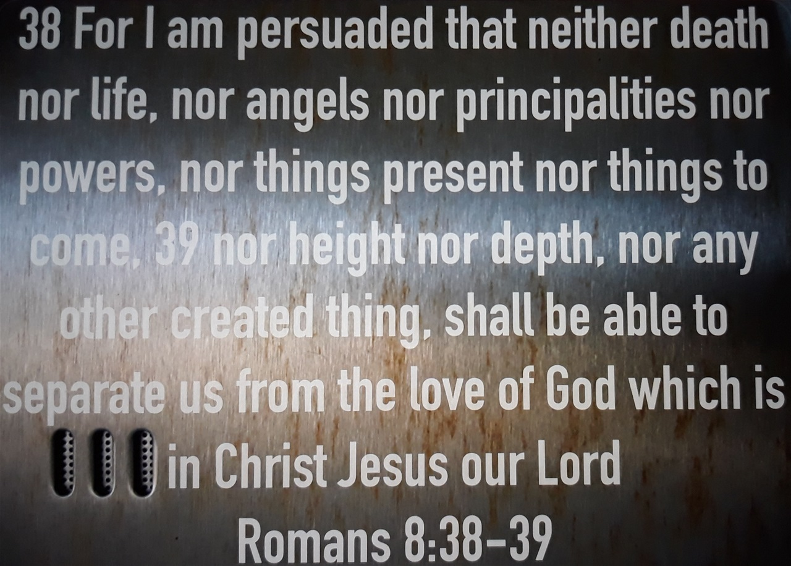
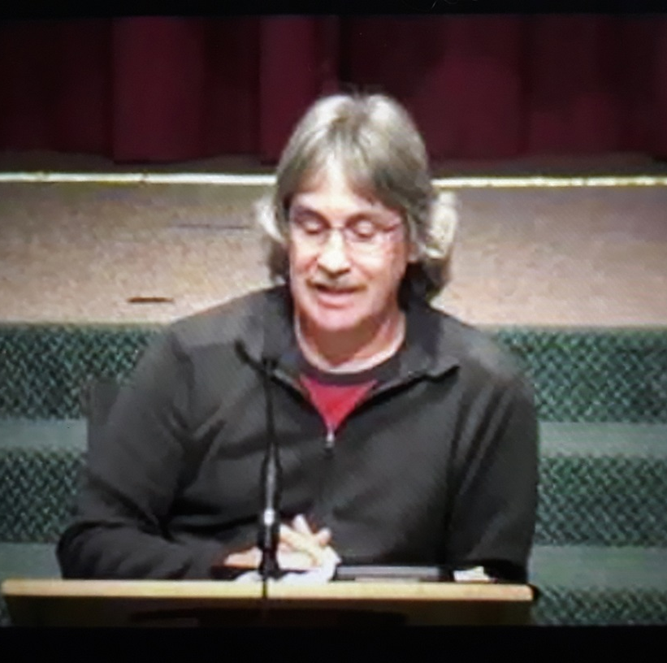
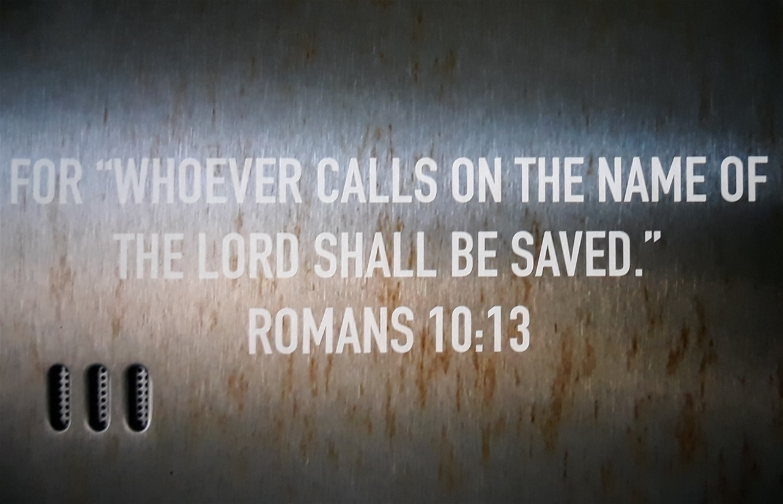
Pastor Chris Quintana
Romans 7:13-8:11
https://youtu.be/HHBkpSz2go0
Romans 8:31-9:13
https://youtu.be/J9IY08eNA1s
Romans 10:1-21
https://youtu.be/TfTyBs3CbuI

Slide 8
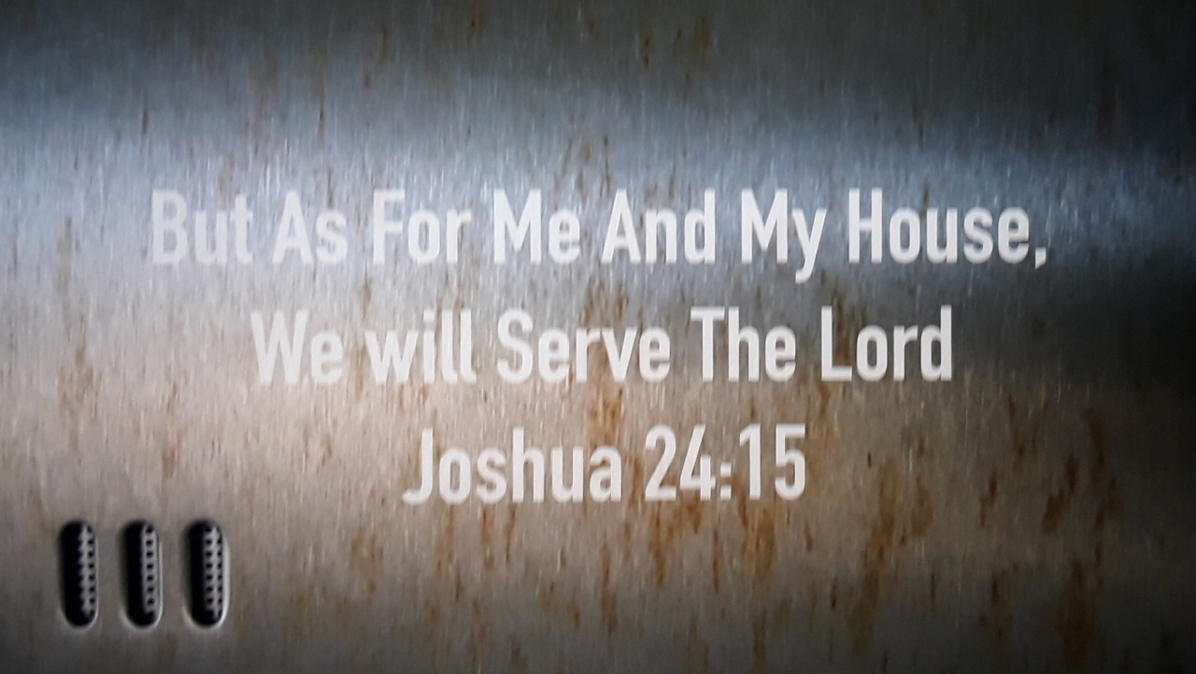
And if it seems evil to you to serve the Lord, choose for yourselves this day whom you will serve, whether the gods which your fathers served that were on the other side of the River, or the gods of the Amorites, in whose land you dwell. But as for me and my house, we will serve the Lord.
Joshua 24:15

Slide 9

For the full study in Romans
& other books of the Bible
https://www.youtube.com/channel/UCT8fi6XUXNBtaQ0hWr9D5pA/videos?app=desktop

