Slide 1
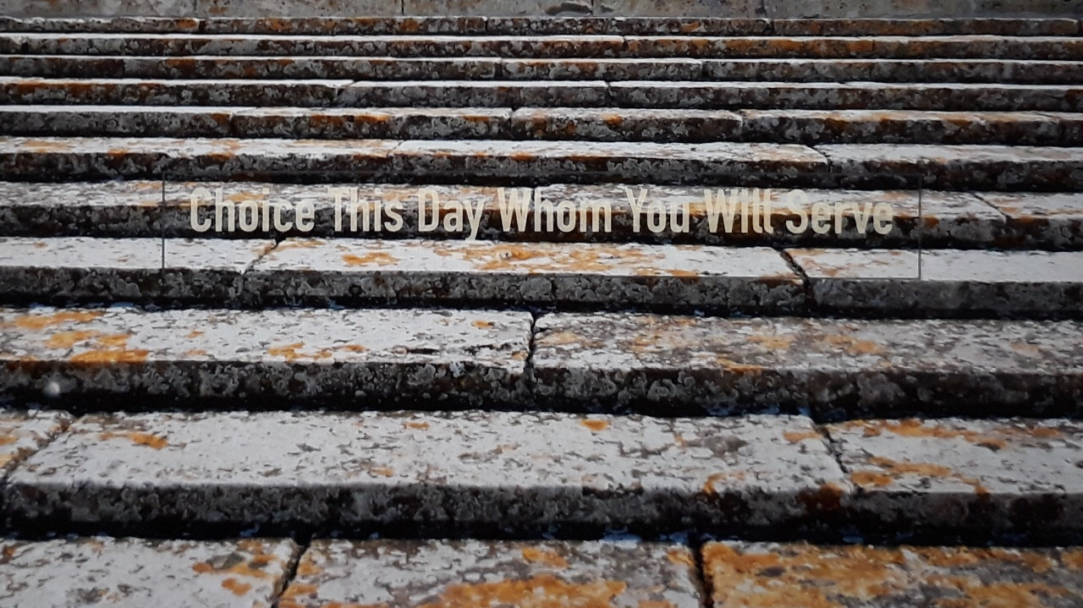
Standing Fast in the last days
The Uncompromising Word
An Urgent Call to a Serious Faith

Slide 2

Table of contents
Standing Fast in the Last Days-Warren Smith
(video clip-full program)
The Uncompromising Word-Pastor Chris Quintana
An Urgent Call to a Serious Faith-Dave Hunt
2 Timothy 3:16-17
The Light of Deception

Slide 3

Standing Fast in the Last Days
https://youtu.be/vn0FOzXp0L0
https://youtu.be/wkxQ0D5BtWE

Slide 4

The Uncompromising Word
Pastor
Chris Quintana
https://youtu.be/H6be1F2sTIM

Slide 5

An Urgent Call to a Serious faith
Part 1
https://www.youtube.com/watch?v=BXbZ7L62gE8
Part 2
https://www.youtube.com/watch?v=RB5kb6wRcMI
Part 3
https://www.youtube.com/watch?v=wE6UzqS4tVs
Part 4
https://www.youtube.com/watch?v=Yg7P9TaXJLs
By Dave Hunt

Slide 6
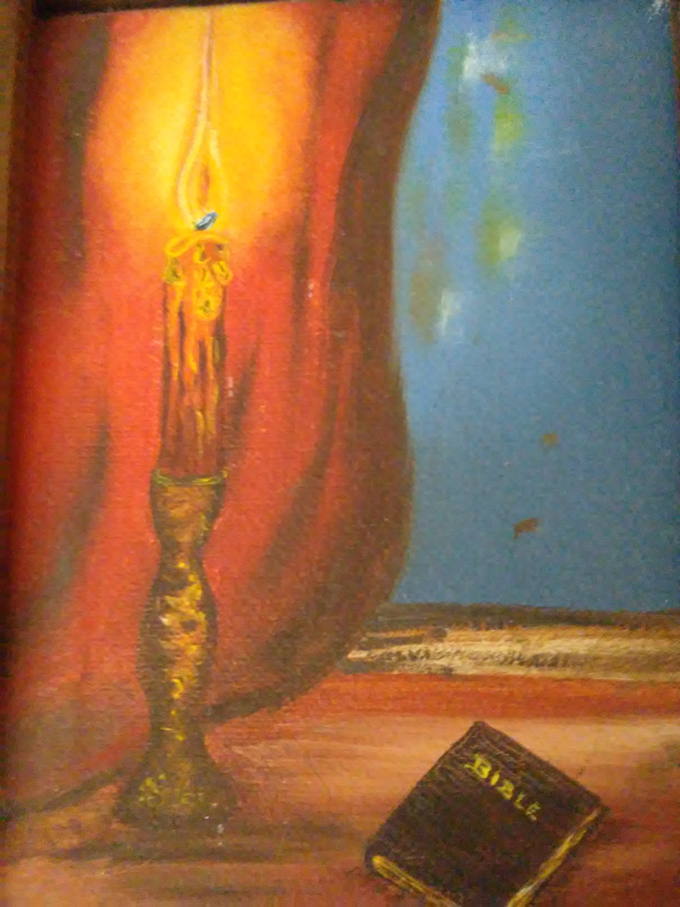
2 Timothy 3:16-17
All Scripture is given by inspiration of God, and is profitable for doctrine, for reproof, for correction, for instruction in righteousness, that the man of God may be complete, thoroughly equipped for every good work.

Slide 7

The Light of Deception
https://www.thelightofdeception.com

