Slide 1
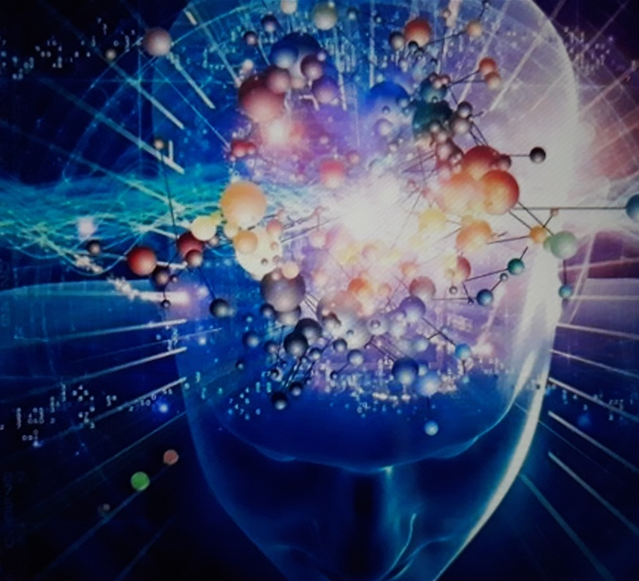
Mystical Deception
The New Spirituality
Within Today’s Churches

Slide 2
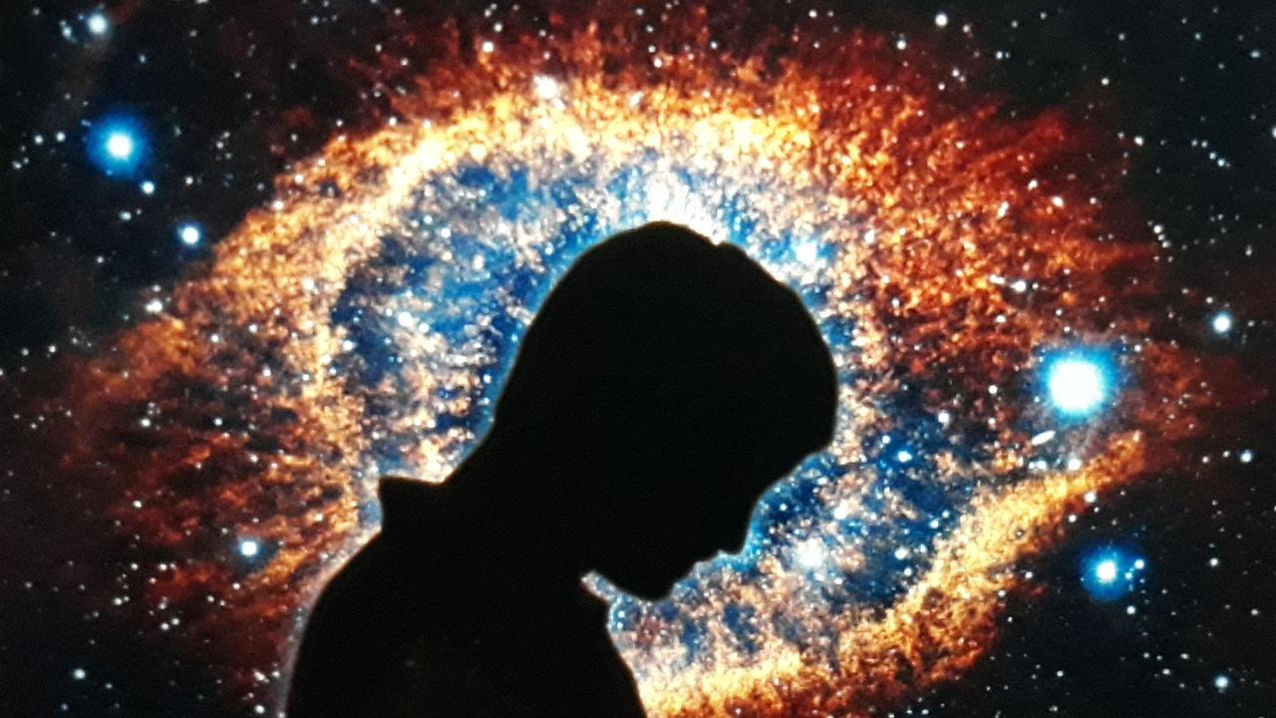
Table of Contents
Definition of Mysticism
Definition of Meditation
Definition of Pantheism
Wide Is The Gate-The New Spirituality
Part 1 (54:55) & 2 (1:01:25) Caryl Matrisciana
Ignorant of Satan's Devices Warren Smith (1:03:46)
Christian Occultists Part 1 (14:30) & 2 (14:30) Johanna Michaelsen
The Emerging Apostasy - T.A. McMahon (1:06:54)
1 Timothy 4:1
Proverbs 14:12
John 14:6
The Light of Deception Website

Slide 3
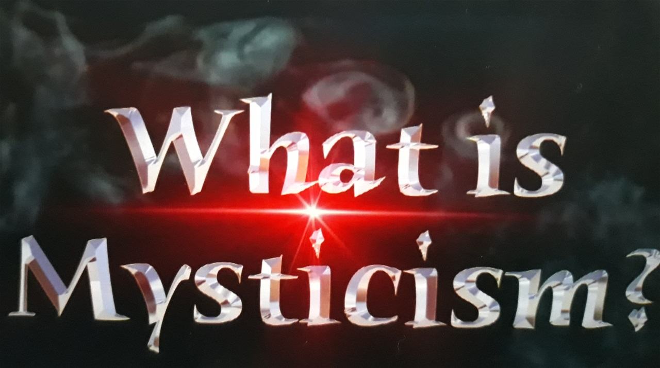
Mysticism Definition
belief that union with or absorption into the Deity or the absolute, or the spiritual apprehension of knowledge inaccessible to the intellect, may be attained through contemplation and self-surrender.
"St. Theresa's writings were part of the tradition of Christian mysticism"
belief characterized by self-delusion or dreamy confusion of thought, especially when based on the assumption of occult qualities or mysterious agencies.
"there is a hint of New Age mysticism in the show's title"

Slide 4
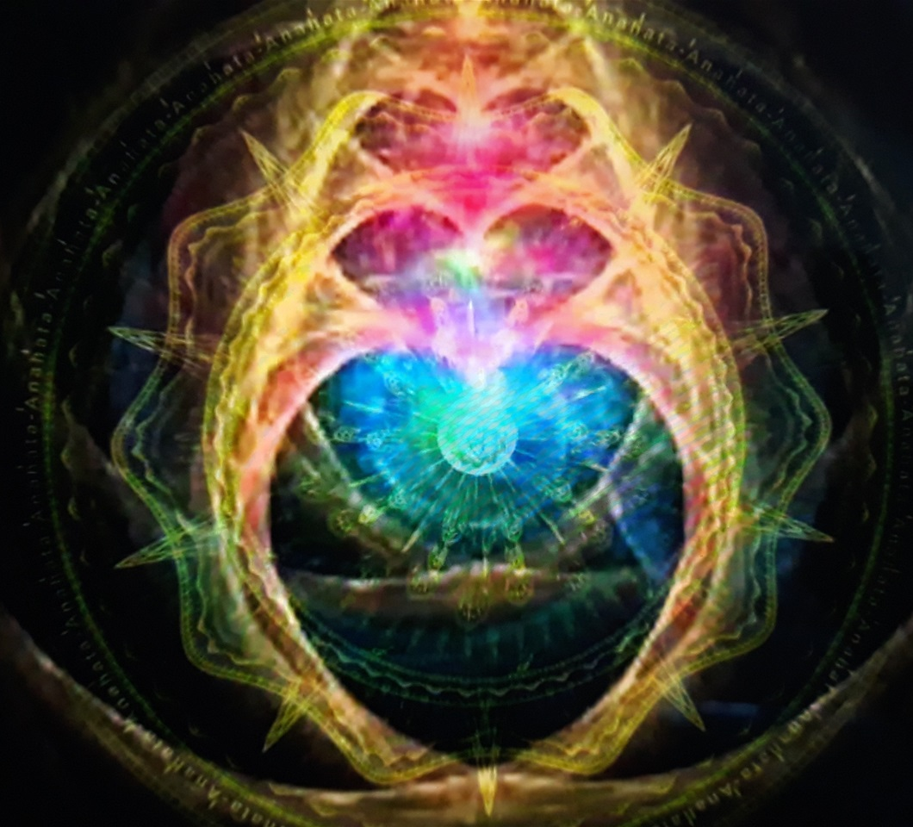
Heart Meditation
Meditation Definition
1 the action or practice of meditating."a life of meditation"
2 synonyms:
3 contemplation , thought, thinking, musing, pondering, consideration, reflection, prayer, deliberation, study, rumination, cogitation, brooding, mulling over, reverie, brown study, concentration, speculation; rare cerebration "cultivating the presence of God in meditation and prayer"
4 a written or spoken discourse expressing considered thoughts on a subject.plural noun: meditations
"his later letters are intense meditations on man's exploitation of his fellows"

Slide 5
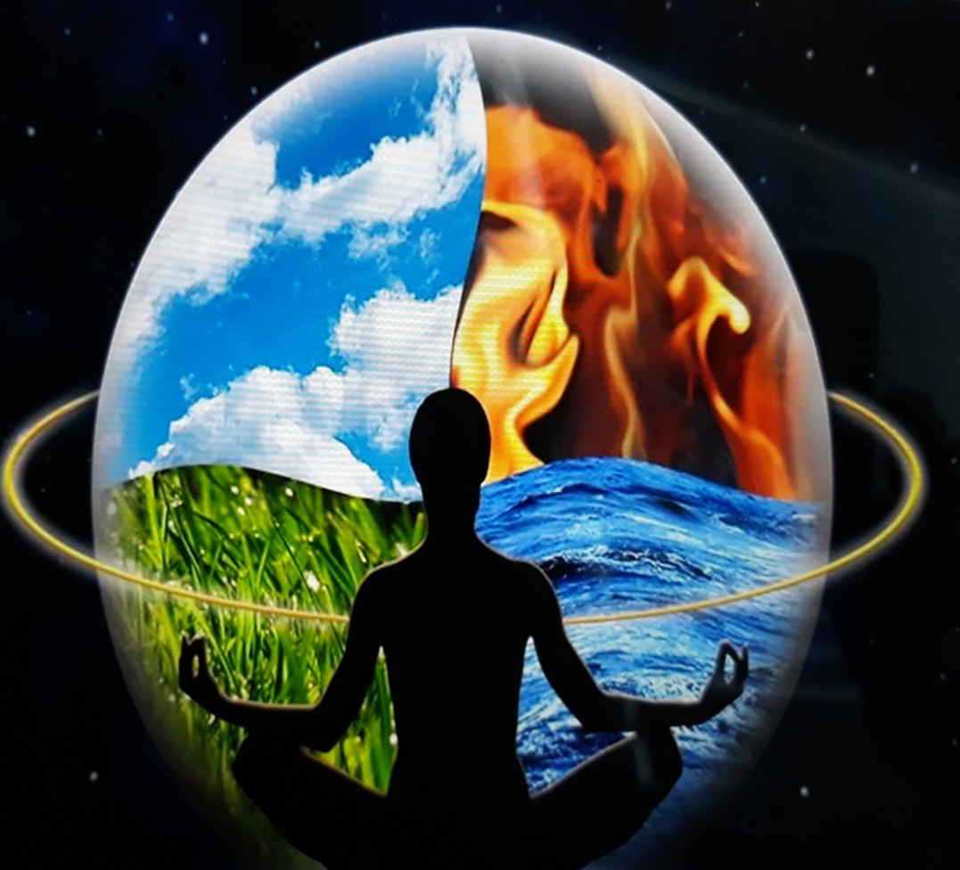
Pantheism and Religion
Pantheistic ideas—and most importantly the belief that God is equal to the universe, its physical matter, and the forces that govern it—are found in the ancient books of Hinduism, in the works of many Greek philosophers, and in later works of philosophy and religion over the centuries. Much modern New Age spirituality is pantheistic. But most Christian thinkers reject pantheism because it makes God too impersonal, doesn't allow for any difference between the creation and the creator, and doesn't seem to allow for humans to make meaningful moral choices.

Slide 6
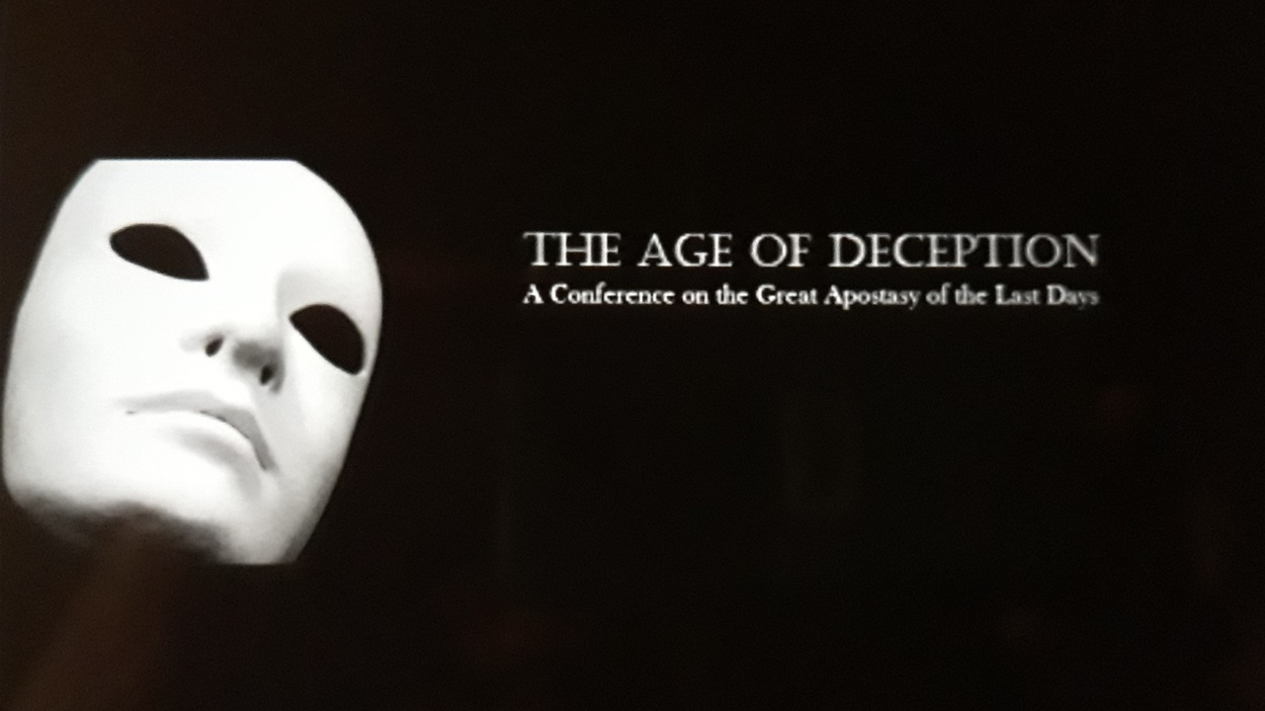
Caryl Matrisciana - Wide Is The Gate
The New Spirituality Part 1 & 2
Caryl Matrisciana - Wide Is The Gate The New Spirituality Part 1
https://youtu.be/LpQ_hXJqmMQ
Caryl Matrisciana - Wide Is The Gate The New Spirituality Part 2
https://youtu.be/BFv0JN94Bwo

Slide 7
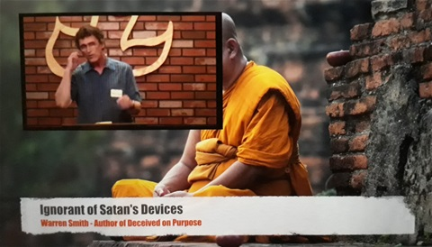
Ignorant of Satan's Devices Warren Smith
https://youtu.be/CMKPWPO34R8

Slide 8
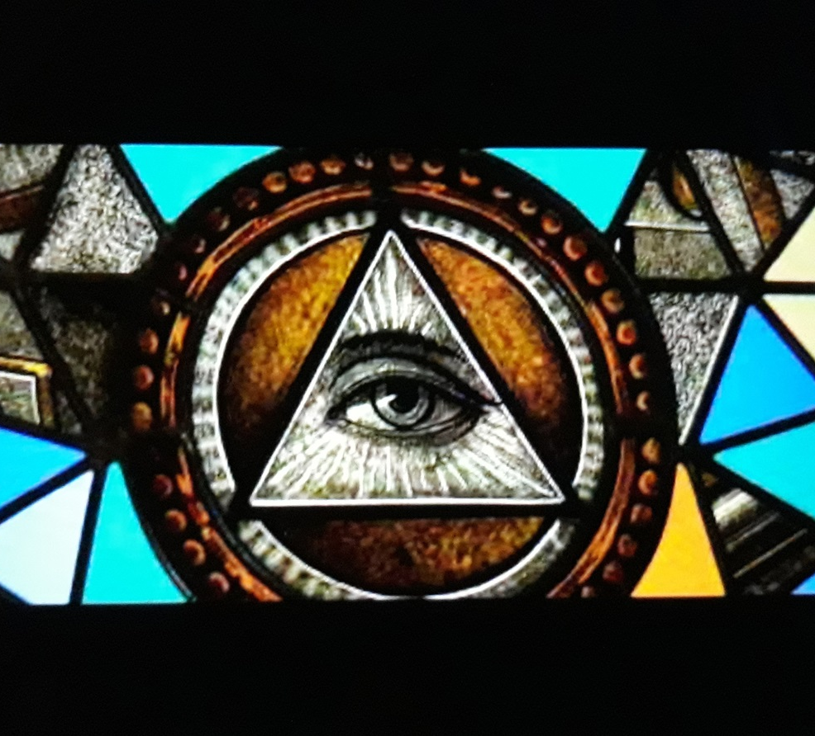
Christian Occultists Johanna Michaelsen Part 1 & 2
Christian Occultists Johanna Michaelsen Part 1
https://youtu.be/YcEBA6wYvag
Christian Occultists Johanna Michaelsen Part 2
https://youtu.be/FxSIUuiz0Wk

Slide 9
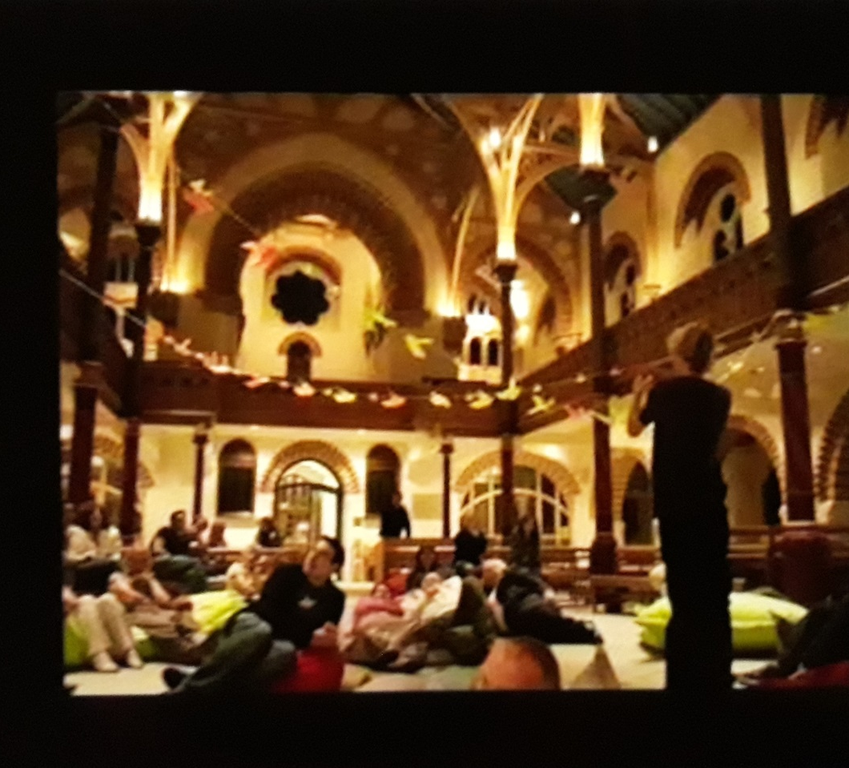
The Emerging Apostasy - T.A. McMahon
https://youtu.be/iA_1FAFaKts

Slide 10
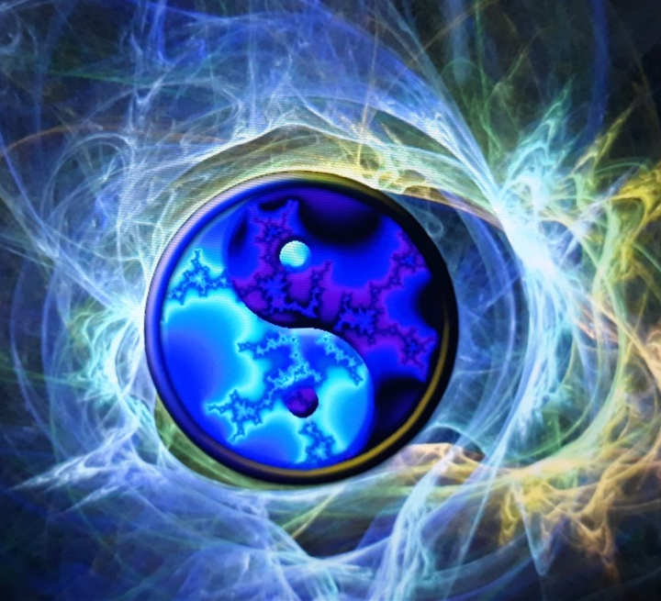
The Great Apostasy
Now the Spirit expressly says that in latter times some will depart from the faith, giving heed to deceiving spirits and doctrines of demons,
1 Timothy 4:1

Slide 11
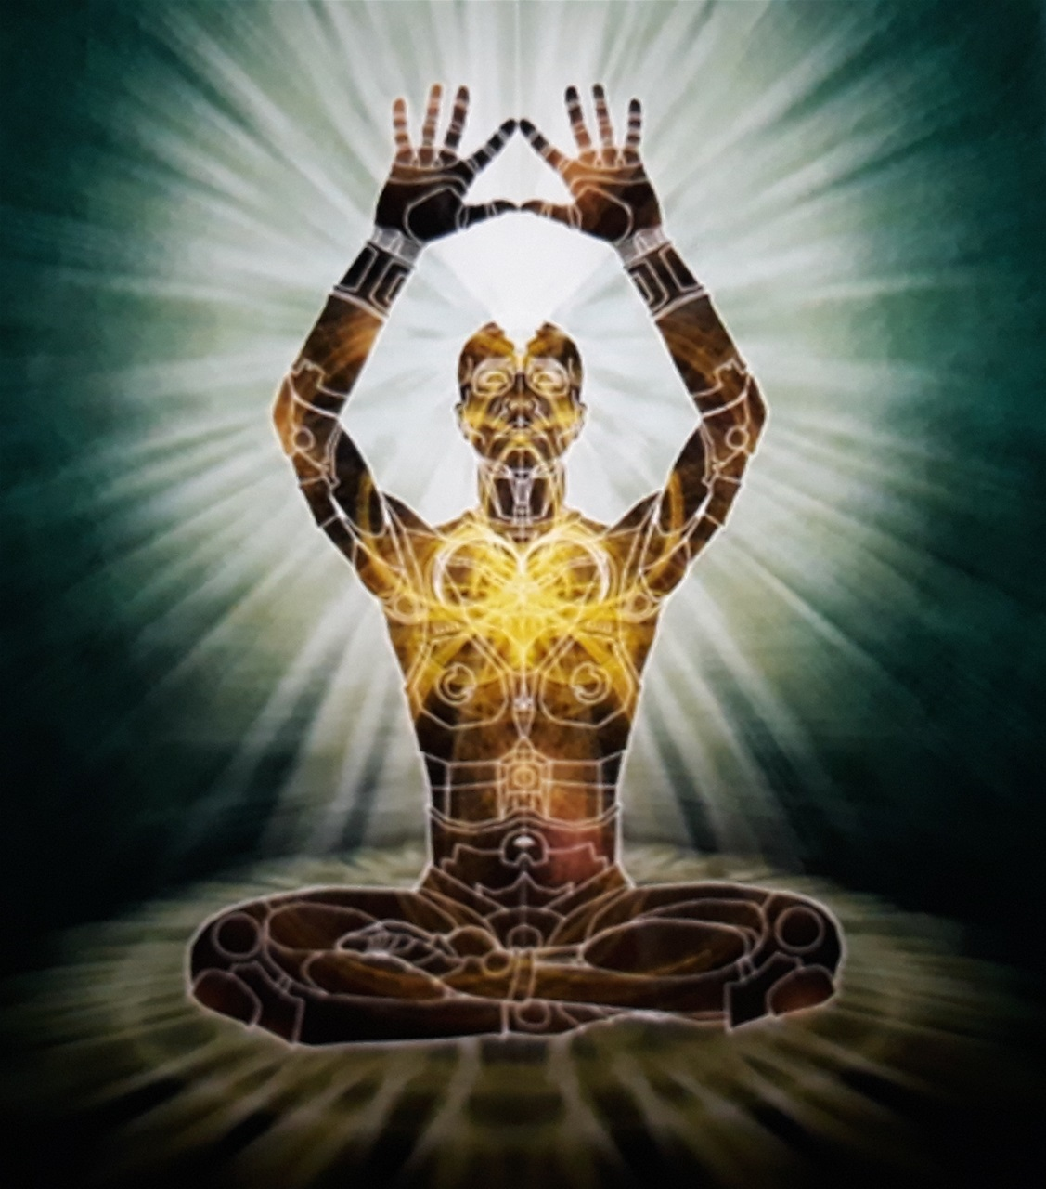
Proverbs 14:12
There is a way that seems right to a man, But its end is the way of death.

Slide 12
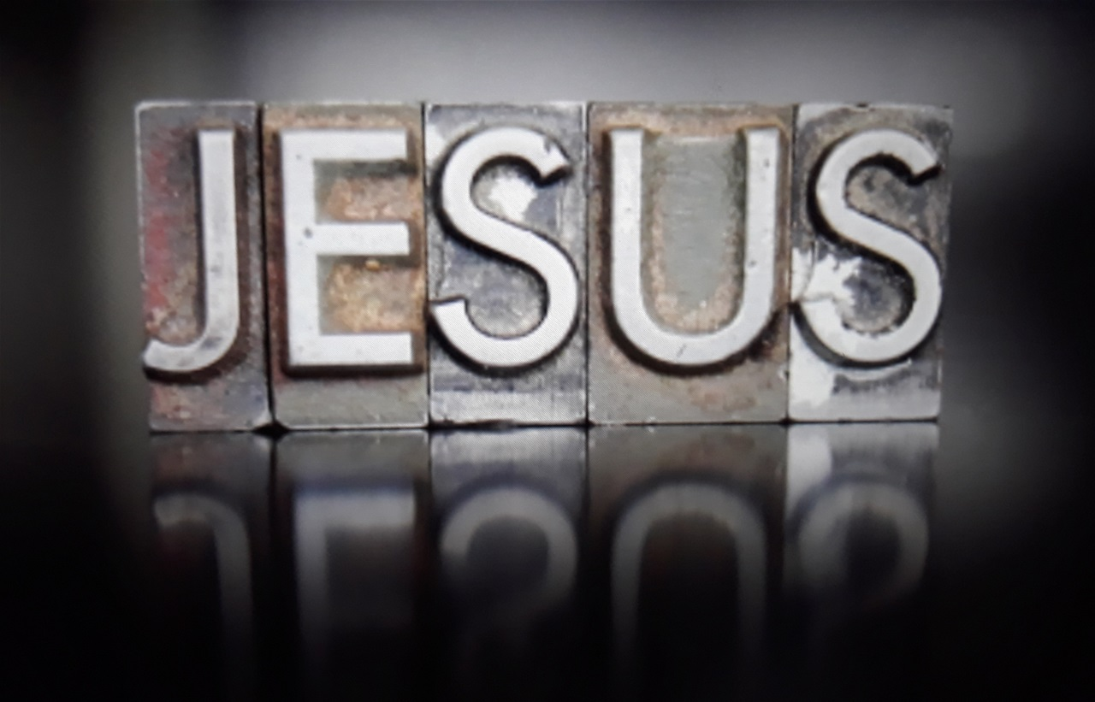
John 14:6
Jesus said to him,
I am the way,
the truth,
and the life.
No one comes to the Father except through Me.

Slide 13
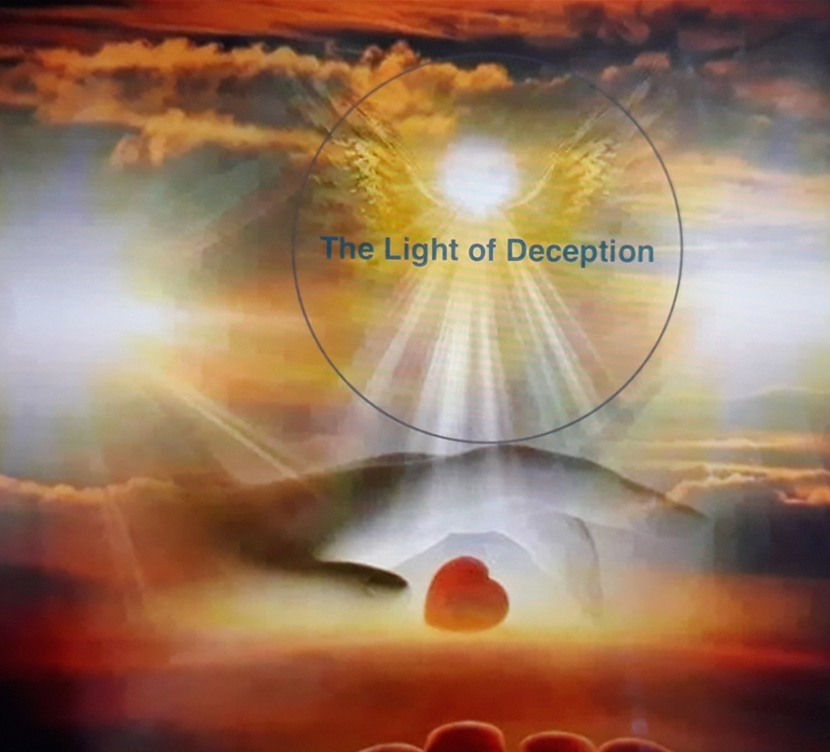
The Light of Deception https://www.thelightofdeception.com

