Slide 1
Inside the global church
Taking a look at global deception
How does the church fit in

Slide 2
Outline for PowerPoint
Global deception (Agenda 2 film Trailer & Renting Options @ $2.99-Length of film 1:27:08)
EXPOSED: Agenda 21/2030 - NWO - Club of Rome - Sustainable Development - Depopulation -14 Jan 2018 (9:07) +Nancy Pelosi promoting Agenda 21: No Conspiracy Theory but a Fact (6:58)
Interfaith dialogue (3-minute clip)
Parliament of world religions (2015/2018 event overview 1o:44/6:27/3:09 video)
Spiritual Politics (short talk on spiritual politics 13:42 video)
Globalism, universalism & ecumenism definitions
Prophecy Source (Europe: Closer to the antichrist 1:11:03 video)
modern church deception (state of the modern church 55:31 video)

Slide 3
Global Deception Agenda 2 Trailer & Renting Options for Film @ $2.99
Trailer https://www.youtube.com/watch?v=eWlHMVgXpk4
Amazon https://www.amazon.com/Agenda-Masters-Deceit-Star-Parker/dp/B077YXB6XH
Vimeo On Demand on Vimeo https://vimeo.com/ondemand/agenda2mastersofdeceit

Slide 4
One World Government

Slide 5
Sustainable Development Goals
This time last year the United Nations approved The 2030 Agenda for Sustainable Development
It introduced 'a new universal agenda' for all mankind. (In other words, a scheduled approach to one world government)
Among those who gave endorsement to the program were US President Barack Obama and Pope Francis
The plan bypasses US Congress and the legislatures of the world's other 193 nations
EXPOSED: Agenda 21/2030 - NWO - Club of Rome - Sustainable Development - Depopulation -14 Jan 2018 https://youtu.be/6vhU1usr6PA
Nancy Pelosi promoting Agenda 21: No Conspiracy Theory but a Fact https://youtu.be/DhK8YG8jw78

Slide 6
Keeping Faith in 2030: Religions and the Sustainable Development Goals
AHRC network Global Challenges Research Fund (Aims of the network)
1) Strengthen voices from the Global South in the production of academic research on religions and development.
2) Create a platform for exchange and dialogue between scholars and faith actors around religions and development, with a focus on the new SDGs.
3) Improve how we research and understand contemporary religions and development activity globally, including refining robust and comparable methods for gathering data and generating evidence.

Slide 7
World top religious leaders joint appeal
https://www.youtube.com/watch?v=jv4YpQEU1sU

Slide 8
Loving world or loving & following the god of scripture
https://m.youtube.com/watch?v=x30vkhMdY20 https://m.youtube.com/watch?v=jfSQIpwLlKg https://youtu.be/g3q_5zYqDJw

Slide 9
Regional interfaith
5 February 2016, Palais des Nations, Geneva – Diplomats from permanent missions, staff members from United Nations entities, leaders from NGOs and representatives of major religions gathered at the event, “Dialogue on Faith, Peace-building & Development,” to discuss the role of faith in peace-building and how faith-based organizations can support social and economic development in synergy with the new 2030 Agenda.

Slide 10
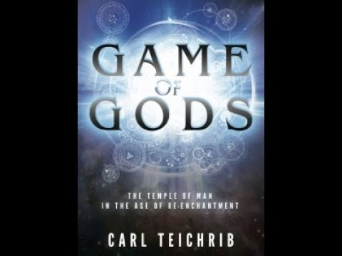
Carl Teichrib short video talk on Spiritual Politics
https://www.youtube.com/watch?v=HBVHEXFS-78

Slide 11
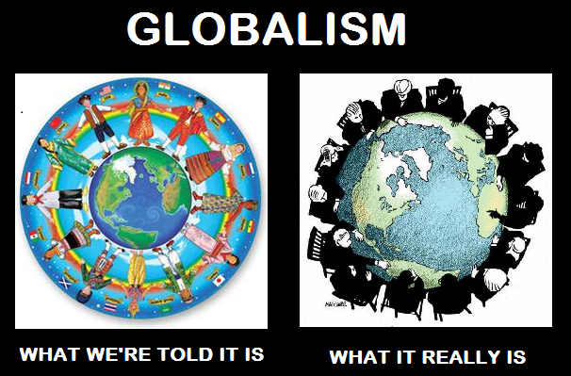
Globalism
Globalism is a term that has been used to refer to various systems with scope beyond the merely international, though in contemporary usage it is primarily used to refer to those that see globalization in a positive light

Slide 12
Universalism
Universalism is a theological and philosophical concept that some ideas have universal application or applicability
A community that calls itself universalist may emphasize the universal principles of most religions and accept others in an inclusive manner

Slide 13
Ecumenism
The term "ecumenism" refers to efforts by Christians of different Church traditions to develop closer relationships and better understandings
The term is also often used to refer to efforts towards the visible and organic unity of different Christian denominations in some form

Slide 14
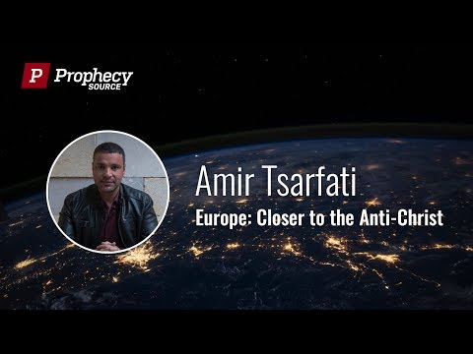
Amir Tsarfati Europe: Closer to the Anti Christ
https://youtu.be/osFi5ckkgWo

Slide 15
How does the church fit in?
Revelation 17:1-18 Describes a time that looks much like the churches of today
How did we get here?
Biblical Illiteracy-Lack of expository teaching
Compromising Biblical Doctrine-To Fill Seats In a Church
Absence of spiritual discernment-False Teachings
Church Asleep-Not listening to warnings
No call to holiness, repentance, & no urgency of the moment

Slide 16
Pastor Chris Quintana State of The Modern Church
https://subsplash.com/ccappletonmedia/lb/mi/+wr6b547

Slide 17
Warnings in scripture 2 Timothy 4:1-5
I charge you therefore before God and the Lord Jesus Christ, who will judge the living and the dead at His appearing and His kingdom
Preach the word! Be ready in season and out of season. Convince, rebuke, exhort, with all longsuffering and teaching
For the time will come when they will not endure sound doctrine, but according to their own desires, because they have itching ears, they will heap up for themselves teachers
and they will turn their ears away from the truth, and be turned aside to fables
But you be watchful in all things, endure afflictions, do the work of an evangelist, fulfill your ministry

Slide 18
What to do with what you know
Question all things
Do research before buying into anyone’s teachings, agendas or claims
Pray, Pray & Pray more (Return to the word of god)
Check everything against the word of god
Find a group of faithful (like minded) bible believing Christians
Let others know about the great deception as God gives you opportunity
Thank God for his faithfulness in showing you truth

Slide 19
Stay the course
2 Timothy 3:16-17 ¹⁶ All Scripture is given by inspiration of God, and is profitable for doctrine, for reproof, for correction, for instruction in righteousness, ¹⁷ that the man of God may be complete, thoroughly equipped for every good work.
Acts 2:42 ⁴² And they continued steadfastly in the apostles’ doctrine and fellowship, in the breaking of bread, and in prayers.
Acts 17:10-11¹⁰ Then the brethren immediately sent Paul and Silas away by night to Berea. When they arrived, they went into the synagogue of the Jews. ¹¹ These were more fair-minded than those in Thessalonica, in that they received the word with all readiness, and searched the Scriptures daily to find out whether these things were so.

Slide 20
Resources from PowerPoint
Opening Logo- https://gohaitimission.webs.com/
Agenda Chart- http://www.agendadocumentary.com/store/p5/NEW%21_AGENDA_CHART_POSTERS.html
The 2030 Agenda One World Government https://christiantoday.com.au/news/the-2030-agenda-one-world-government.html
Keeping Faith in 2030: Religions and the Sustainable Development Goals https://www.leeds.ac.uk/arts/news/article/4821/keeping_faith_in_2030_religions_and_the_sustainable_development_goals
Geneva-UNITAR Hosts Dialogue on Faith, Peacebuilding & Development http://regionalinterfaith.org.au/?tag=geneva
Definitions Taken from-https://www.wikipedia.org/

Slide 21
Additional Teachings Deception within today’s churches
"Anger, Vitriol and Venom" From the Parliament of the World's Religions https://www.lighthousetrailsresearch.com/blog/?p=29041&fbclid=IwAR2XcoebbTD-nO1EvgmcuH7CqtBiKDGV2zmBtsqpRkNvLKVGxTQGxZ236kE
One World Religion and Liberal ‘Christian’ Contradictions https://standupforthetruth.com/2018/11/one-world-religion-and-liberal-christian-contradictions/
Learning From Rome https://www.lighthousetrailsresearch.com/blog/?p=29111
"Together 2018" - "A New Jesus Movement" for a Mystical All-Inclusive "Christianity https://www.lighthousetrailsresearch.com/blog/?p=28930
Liberal Theology Making its Way Into the Church https://www.youtube.com/watch?v=RD8MQKJN3ng
The “Jesus” of A Course in Miracles https://www.lighthousetrailsresearch.com/blog/?p=29115&fbclid=IwAR1ue1KpmUQR0rs0qrYNbmEkCCu6ccg9xayCxk4HT32I48pCimHYmWMqFxA
Deception in the Church - (The Old Path, Part 1 of 4) https://m.youtube.com/watch?sns=fb&fbclid=IwAR08tPYGepHpYoMna3Et4icL_uEWyfiLu2oSM0_x80LKtzeHHzF9dmqcznk&v=6Bah0JlwVRA
Deception in the Church - (The Old path, Part 2 of 4) https://m.youtube.com/watch?fbclid=IwAR0gGNbI8ZFnPmxR9IKD26d-1e7odlD14KdrZ4mUVgk278jhV8TGvMcv_HI&sns=fb&v=AEP5dWQMc2E

Slide 22
Additional Teachings Deception within today’s churches
Presenting A Different Jesus https://www.thebereancall.org/content/presenting-different-jesus?fbclid=IwAR0xgOsunwCPfxScVzgvsfbHMZCE9RUOmI-bUcorhxRL2uQuznHPbgOtGgs#.W0o9YGa1pMs.facebook
The Emerging Apostasy - T.A. McMahon https://m.youtube.com/watch?fbclid=IwAR1DJjRxQHUj5o6IaU5fF8SHdVLNLZ6ZP_jJsadmqSYbel-otyM9KNDEJ80&sns=fb&v=iA_1FAFaKts
Refuting Emergent Church Ideas with Chris Quintana https://m.youtube.com/watch?fbclid=IwAR3OfbJPqssoeKfjAxT8JhRF-6j_PibEz7PVxNsqh2bVsMPfjbHpIT2HC1g&sns=fb&v=WqTalGDrPEw
Wide Is The Gate: The Emerging New Christianity Volume 1 https://m.youtube.com/watch?v=mWvTUX9okuM&fbclid=IwAR1IcvHPdgrd6ksV4YuL8l9lLlxmAwp3-tOe-UPQzwncans2M9uookmcgmc&sns=fb
Wide Is The Gate: The Emerging New Christianity Volume 2 https://m.youtube.com/watch?sns=fb&fbclid=IwAR1-ZK96LN3FEX-RLJAsX8gz8T5bt2hbg73AQJvfHlEBUGnCpsmYyBdMtLY&v=bDBoBhIqfwQ
Falling to 'Peaces' Excerpts https://m.youtube.com/watch?fbclid=IwAR1cJCzeytR1KXA0Neu8PZCOV8zHdai5HGz6QsfmYBMd8UEt2FW8d8ssN8I&feature=share&v=4T8LCmpIbyo
The Silent Church in the Day of Apostasy https://www.lighthousetrailsresearch.com/blog/?p=22953&fbclid=IwAR2cJtG0toD6EXJFtoIe3MqRlg7oe_HFn2qEgU-vl9A8J3voqSsj4vau2Qg

Slide 23
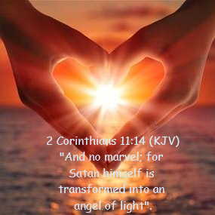
For more teachings on Deception
Visit-The Light of deception website or media and news site on Facebook
thelightofdeception.simplesite.com - facebook.com/thelightofdeception/

