Slide 1
How To Know When You’re deceived
Warning Signs & Pitfalls
https://www.thelightofdeception.com

Slide 2
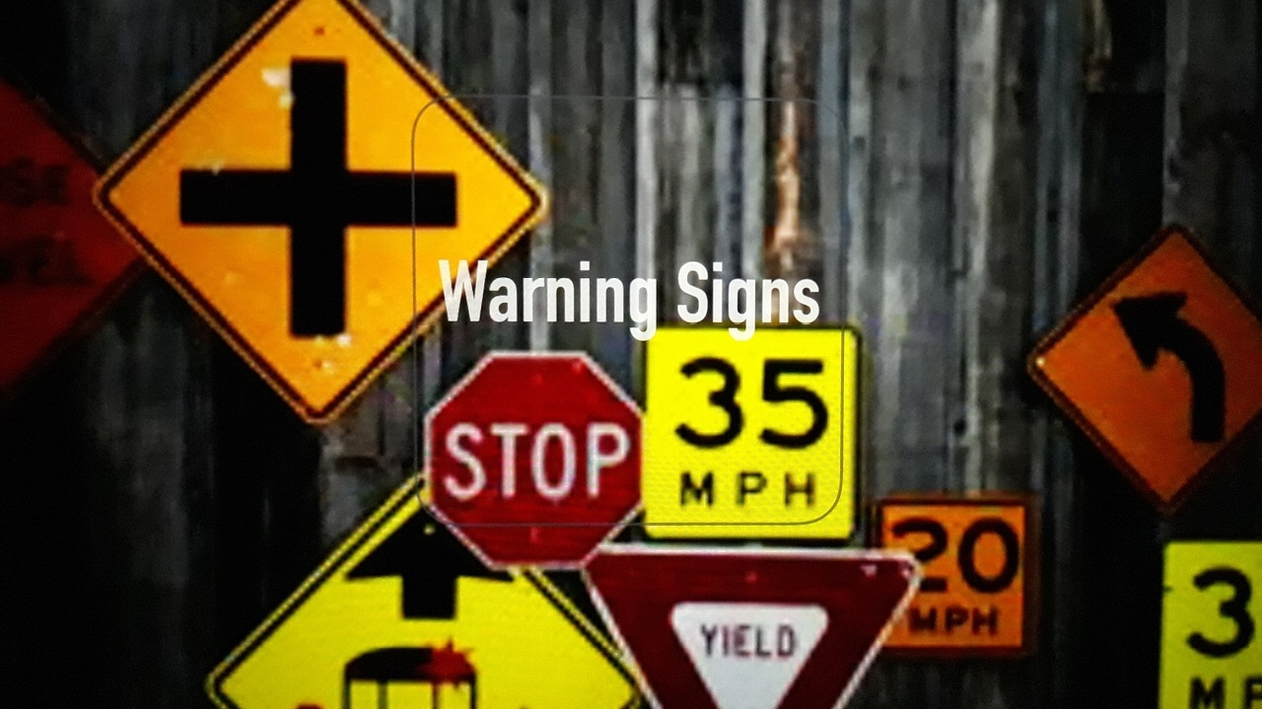
Table of contents
The Right Hand of Falsehood-Warren B Smith
False Teachers-Exposing Them & Naming Them By Name-Love For The Truth
Falling to 'Peaces' Excerpts-Dana Malchow
Every Wind of Doctrine – Pastor Barry Stagner
The Time Is At Hand

Slide 3
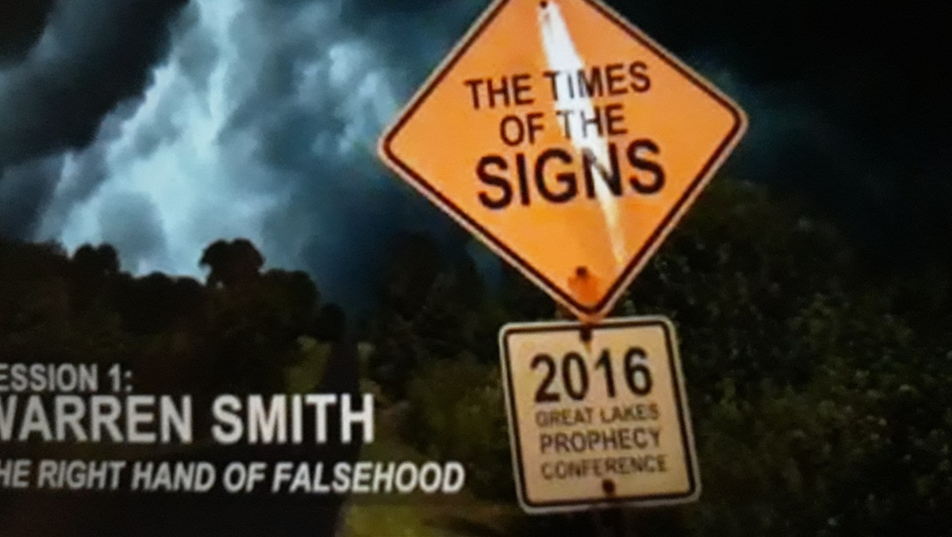
Great Lakes Prophecy Conference Warren B Smith The Right Hand of Falsehood
https://youtu.be/ZiR1bProdoc

Slide 4
False Teachers Exposing Them & Naming Them By Name
https://youtu.be/-wJ5S3QzcI8

Slide 5
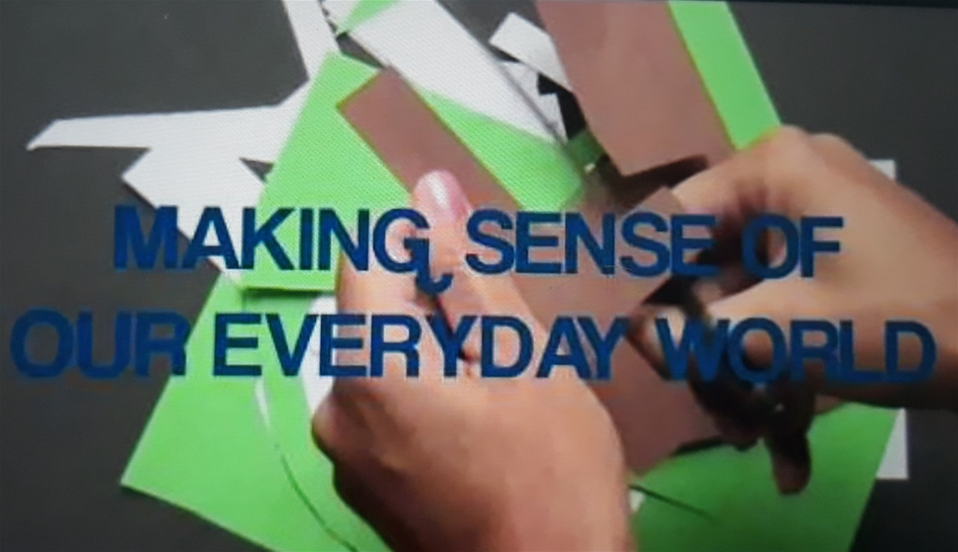
Falling to 'Peaces' Excerpts
https://youtu.be/4T8LCmpIbyo

Slide 6
Every Wind of Doctrine
https://youtu.be/7LzO_QyaRxQ

