Slide 1
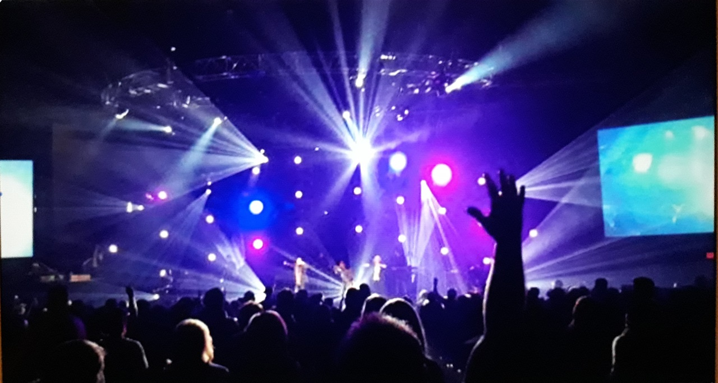
Entertaining The Masses
Church Service or Concert?

Slide 2
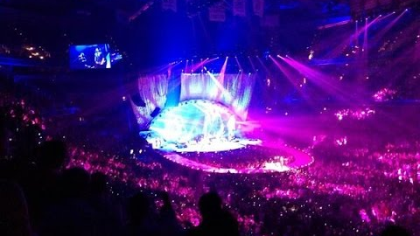
Largest Christian Rock Concert in History!
Looking at Church Deception

Slide 3
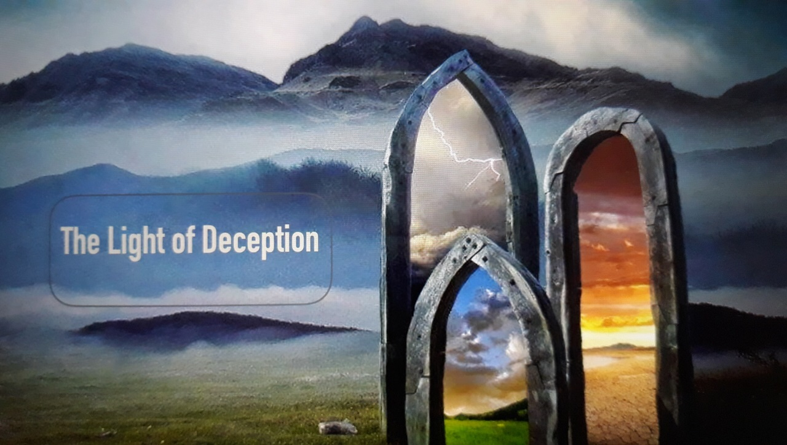
Table of Content
Teachings by Pastor Chris Quintana
What is a Seeker Sensitive Church?
What is the Emergent Church?
Refuting Emergent Church Ideas
Deception in the Church-The Old Path
https://www.thelightofdeception.com

Slide 4
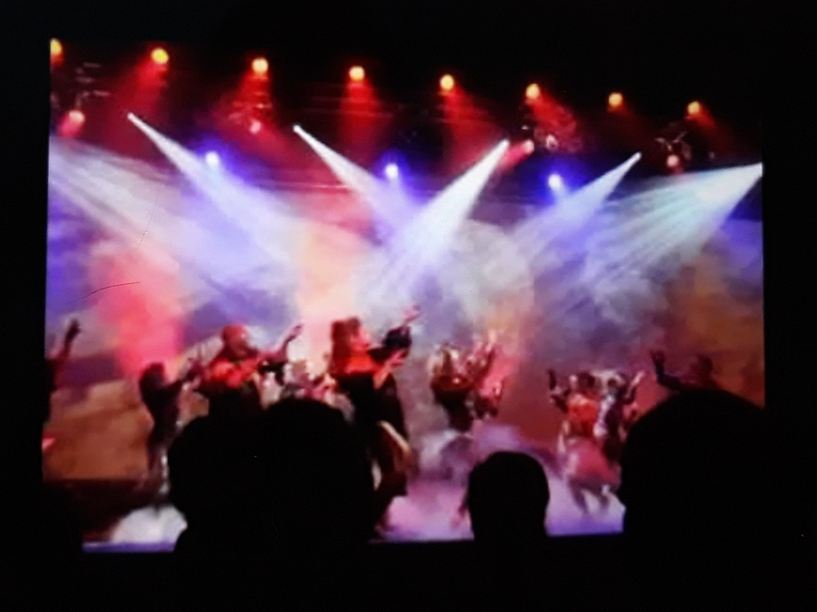
What is a Seeker Sensitive Church?
Pastor Chris Quintana
https://youtu.be/g2ilEr5E1HI

Slide 5
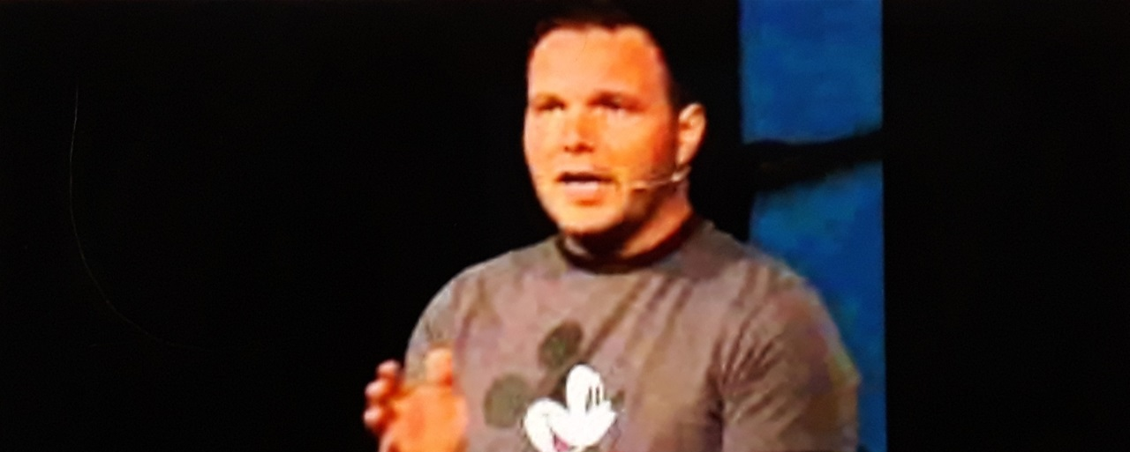
What is the Emergent Church?
Pastor Chris Quintana https://youtu.be/fxwbpYAxWsw

Slide 6

Refuting Emergent Church Ideas with Chris Quintana
https://youtu.be/WqTalGDrPEw

Slide 7
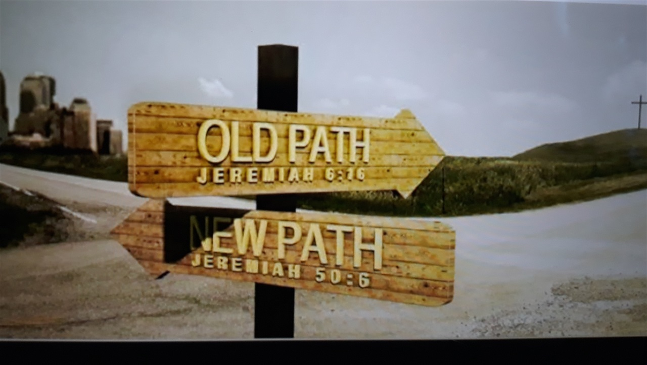
Deception in the Church
The Old Path
Part 1
https://youtu.be/6Bah0JlwVRA
Part 2
https://youtu.be/AEP5dWQMc2E

Slide 8



Calvary Old Path
Rightly Dividing the Word
https://m.youtube.com/channel/UCT8fi6XUXNBtaQ0hWr9D5pA/videos

