Slide 1
Bible Prophecy
Signs of the Times

Slide 2
Table of Content
Why We May Be the Terminal Generation Trailer
Understanding The Times
Are We the Terminal Generation: 15 Signs of His Imminent Return?
Understanding The Times
Falling Into Place-The Top 10 Bible Prophecy Related Stories of 2018
Jan Markell-Olive Tree Ministries
Prophecy Update: Turkey, Iran, Russia in Syria. Rise of Apostasy.
Spiritual Abuse-Worldview Weekend News

Slide 3
Why We May Be the Terminal Generation Trailer https://youtu.be/vffUWs16F3Y
Are We the Terminal Generation: 15 Signs of His Imminent Return?
https://youtu.be/YJKLnmOLTiY

Slide 4
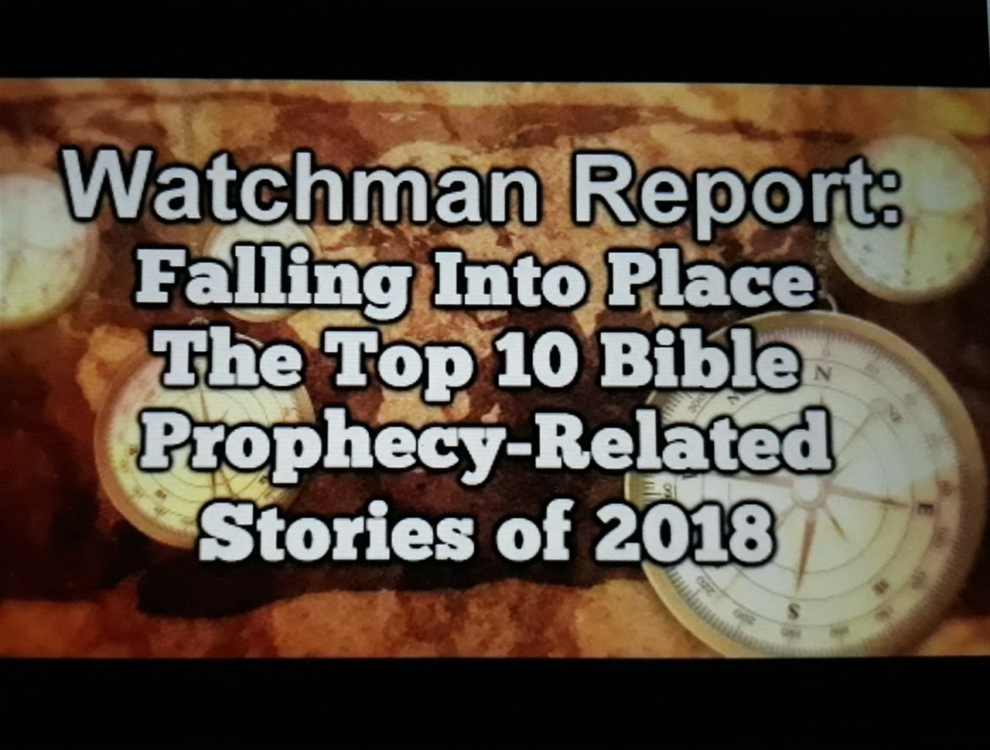
Falling Into Place The Top 10 Bible Prophecy Related Stories of 2018
Watchman Report
https://m.youtube.com/watch?v=Vdl6OXjWvAk

Slide 5
Prophecy Update: Turkey, Iran, Russia in Syria. Rise of Apostasy. Spiritual Abuse https://youtu.be/dhaHpbXcE2o

Slide 6
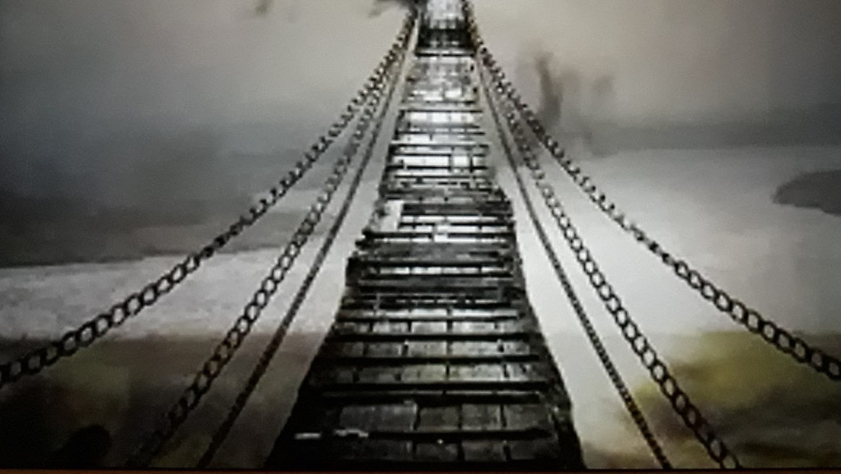
The Light of Deception https://www.thelightofdeception.com

