Slide 1
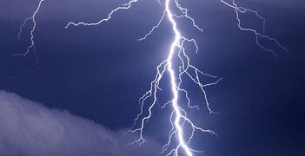
AS IN THE DAYS OF NOAH

Slide 2

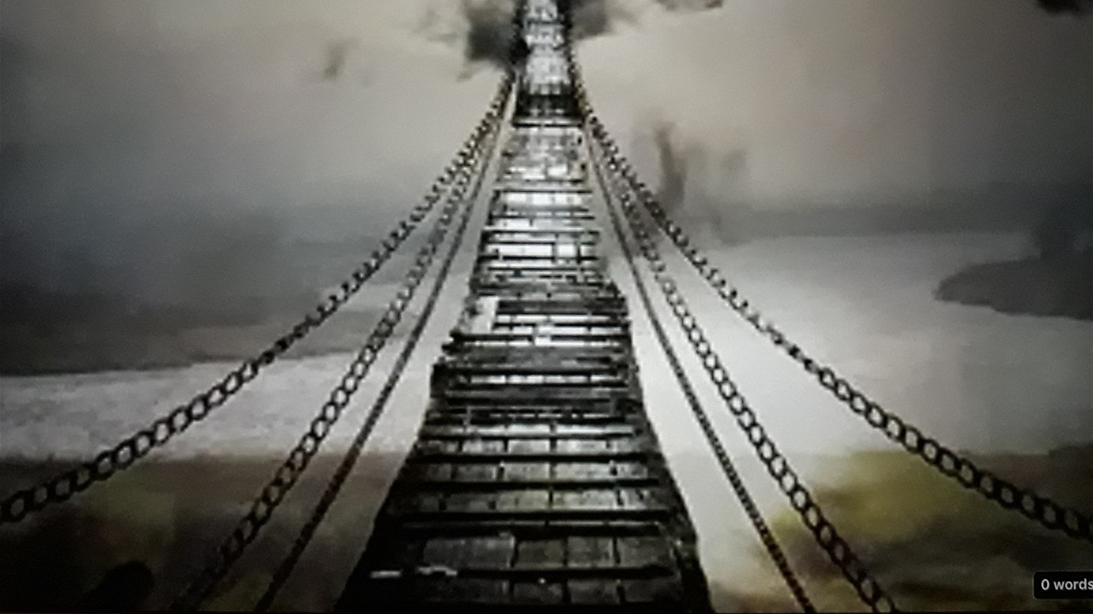
TABLE OF CONTENTS
As in the Days of Noah
Barry Stagner
End Times
Pastor Chris Quintana
Eschatology
Pastor Chris Quintana

Slide 3
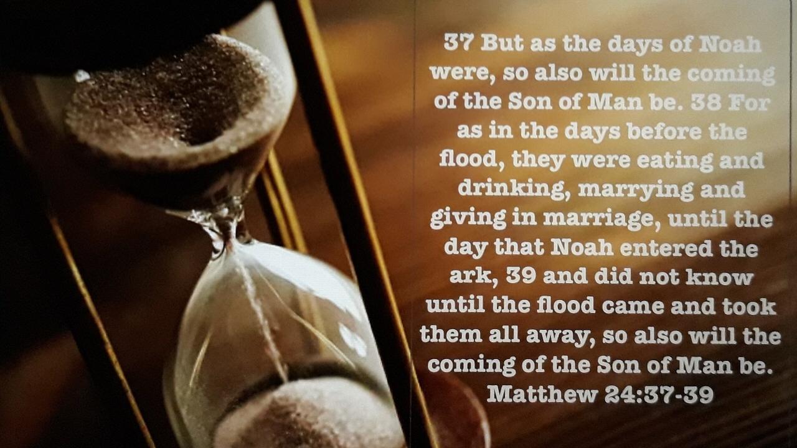

Slide 4

As in the Days of Noah https://youtu.be/6V9-vwuzIz4

Slide 5
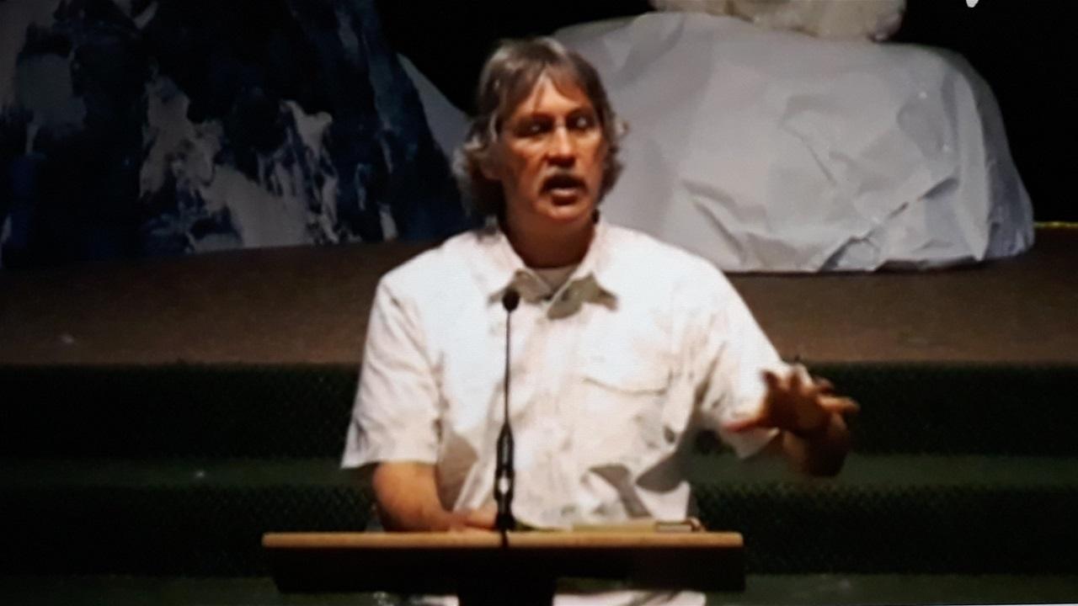
End Times-Pastor Chris Quintana
Matthew 24: 1-14
https://youtu.be/ezdvSXzN0-o
Matthew 24: 15-22
https://youtu.be/czENar4Hv0s
Matthew 24: 23-31
https://www.youtube.com/watch?v=G8mLcoa4B1w

Slide 6
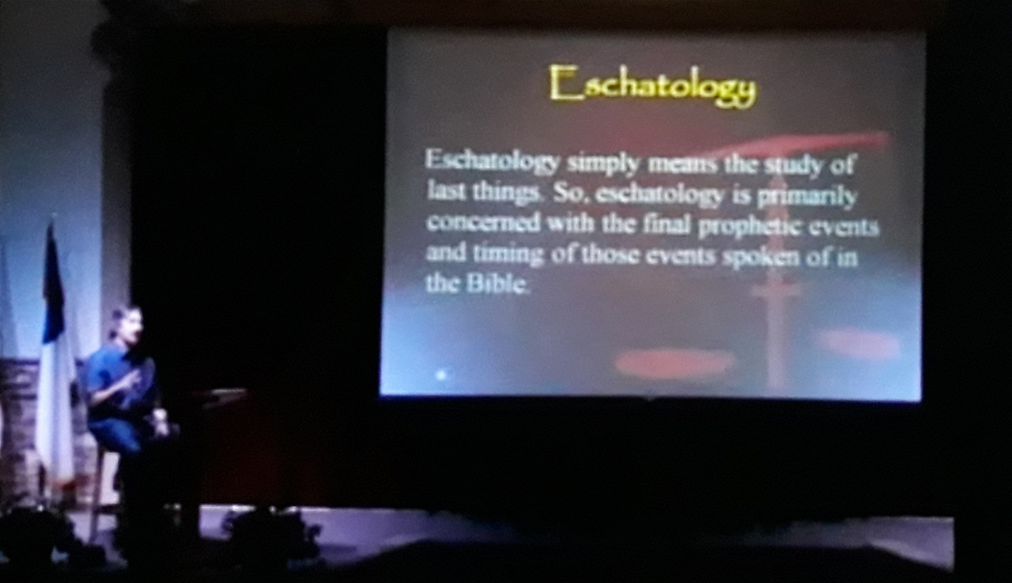
Eschatology-Pastor Chris Quintana
Part 1
https://youtu.be/LwawebnyX3g
Part 2
https://youtu.be/9ZJ3JpoyRxU

Slide 7

KNOWING THE TIMES https://www.thelightofdeception.com

